Slide 1

Fabrication of Protoyping and Lab
Deva Uçar ​
Umar Ansari

Slide 2
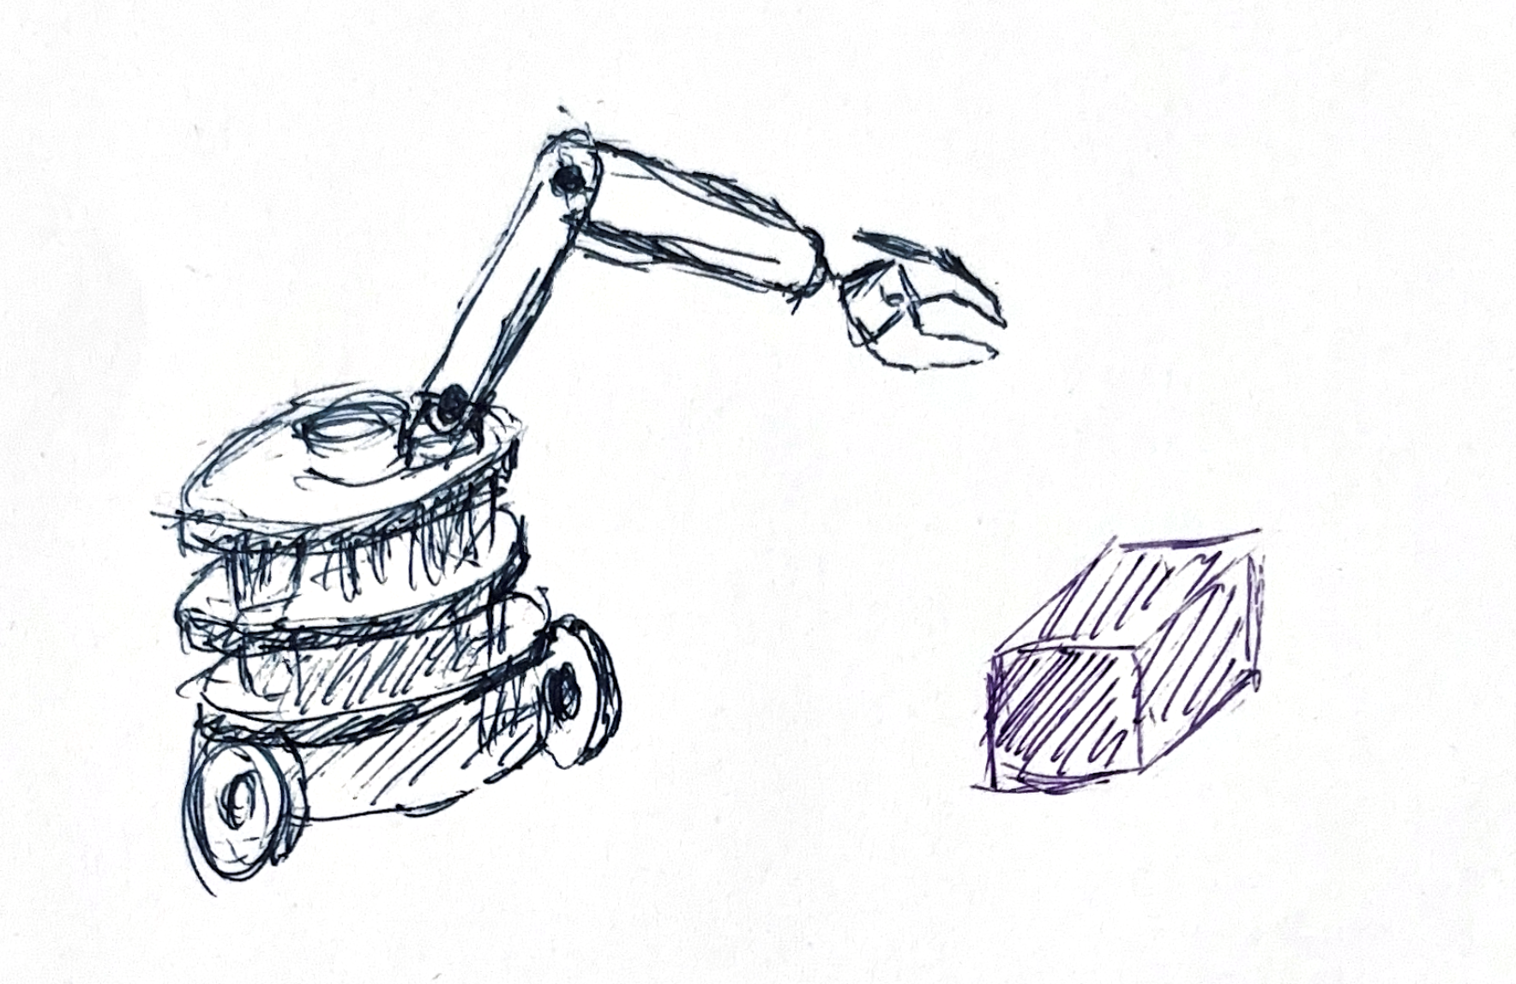
OUR IDEA
A 4-DOF robotic arm to carry random stuff to the feet of the main character.
The dramaturgical role of the robot ->
Since the play is about someone who is stuck, the robot will represent his loved ones trying to do random stuff for them to get them out of their situation. But since the objects are random it can not be helpful for the person.

Slide 3
Properties of The Robot
Apply computer vision to detect object that can be picked up, around the area.
Pick up the object.
Determine the exact place to drop the object.
Drop the object.

